Slide 1

WIN PREDICTION FOR IT CONSULTING DEALS
PROJECT PROPOSAL

Slide 2
EXECUTIVE SUMMARY
The purpose of this proposal is to present a predictive model that can accurately forecast the likelihood of winning IT consulting deals. By leveraging historical deal data, the proposed solution will enable your organization to identify high-probability opportunities, optimize resource allocation, and improve overall business outcomes.
Key Benefits:
Improved deal closure rates by focusing on high-probability opportunities.
Data-driven insights into factors that impact deal success.
Enhanced strategic decision-making for IT consulting services.

Slide 3

PROJECT OBJECTIVES
Our key objectives for this project are:
Predictive Accuracy: Build a machine learning model to predict the win/loss outcome of each deal.
Actionable Insights: Identify key factors (e.g., client category, deal cost, solution type) that drive deal success.
Strategic Value: Enable the sales and management teams to make informed, data-driven decisions that enhance win rates.

Slide 4
DATA REVIEW & CHALLENGES
We have two key datasets* representing global and Indian consulting deals. These datasets provide detailed information on deal characteristics, including:
Client Category (Enterprise, Non-Profit, Start-up)
Deal Cost, Contract Length, Sector
Deal Status (Won/Lost), Deal Risk Factor, Client Satisfaction
Challenges Identified:
Missing Data: Certain fields, such as Deal Probability, contain missing values.
Inconsistent Formatting: Date and cost fields need standardization.
Categorical Variables: Multiple categorical fields (e.g., Client Category, Manager Name) need to be transformed for modeling.
*Doubt: what's the point of having two datasets?

Slide 5
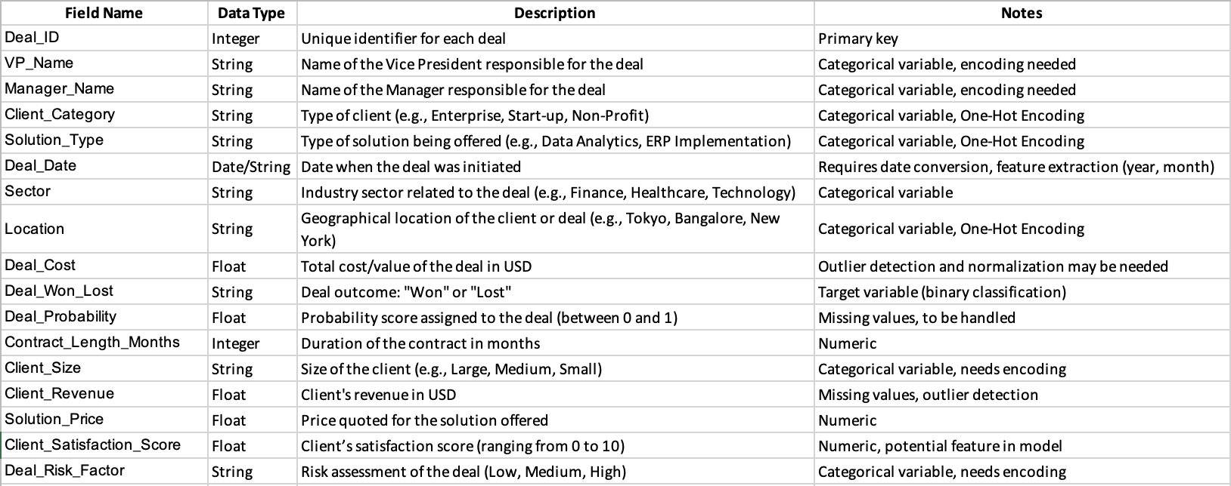
DATA DICTIONARY GLOBAL KPMG CAPSTONE

Slide 6
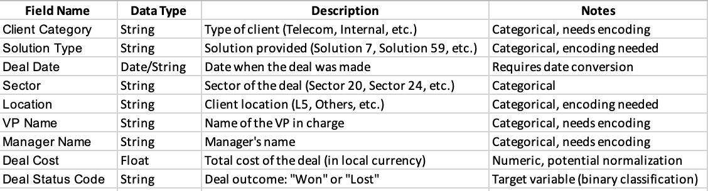
DATA DICTIONARY INDIA KPMG CAPSTONE

Slide 7
PROPOSED APPROACH
Data preprocessing
EDA
Feature Engineering
Model Training/Testing
Model Optimization
Delivery

Slide 8
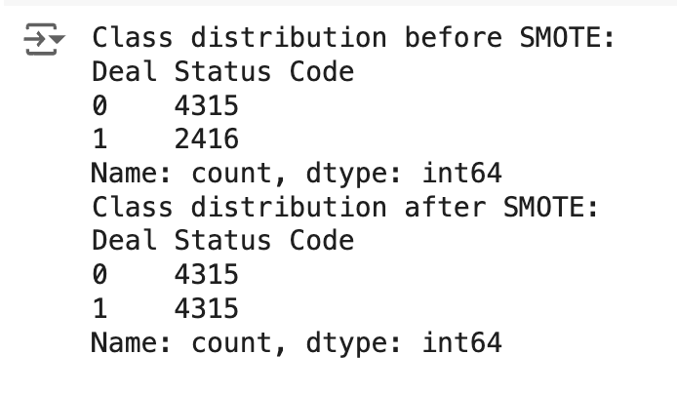
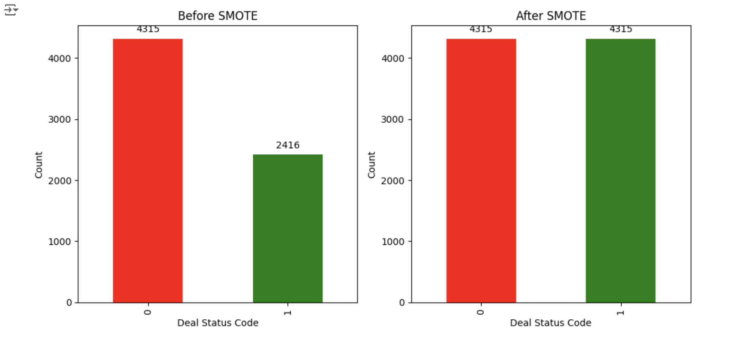
DATA DISTRIBUTION FOR INDIA DATA

Slide 9
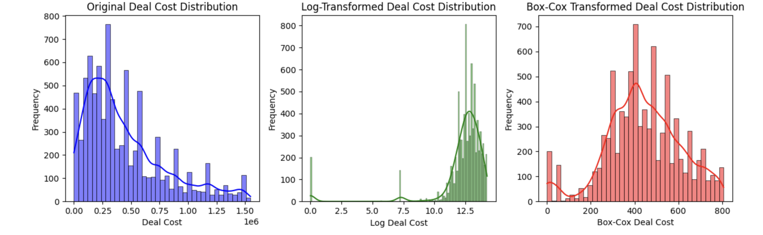
DATA DISTRIBUTIONS

Slide 10
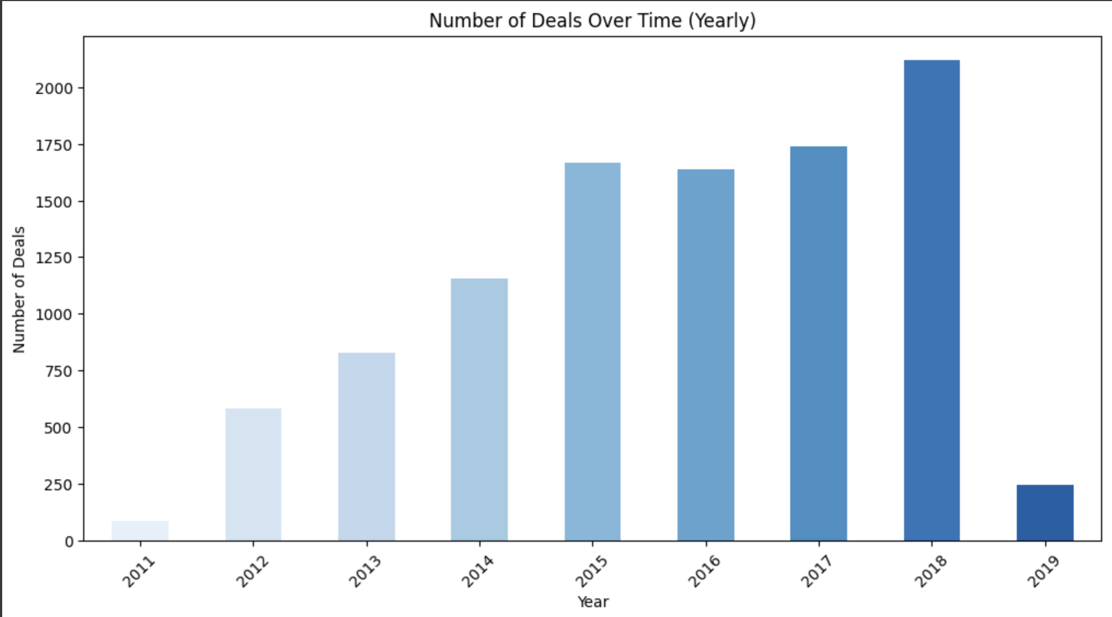
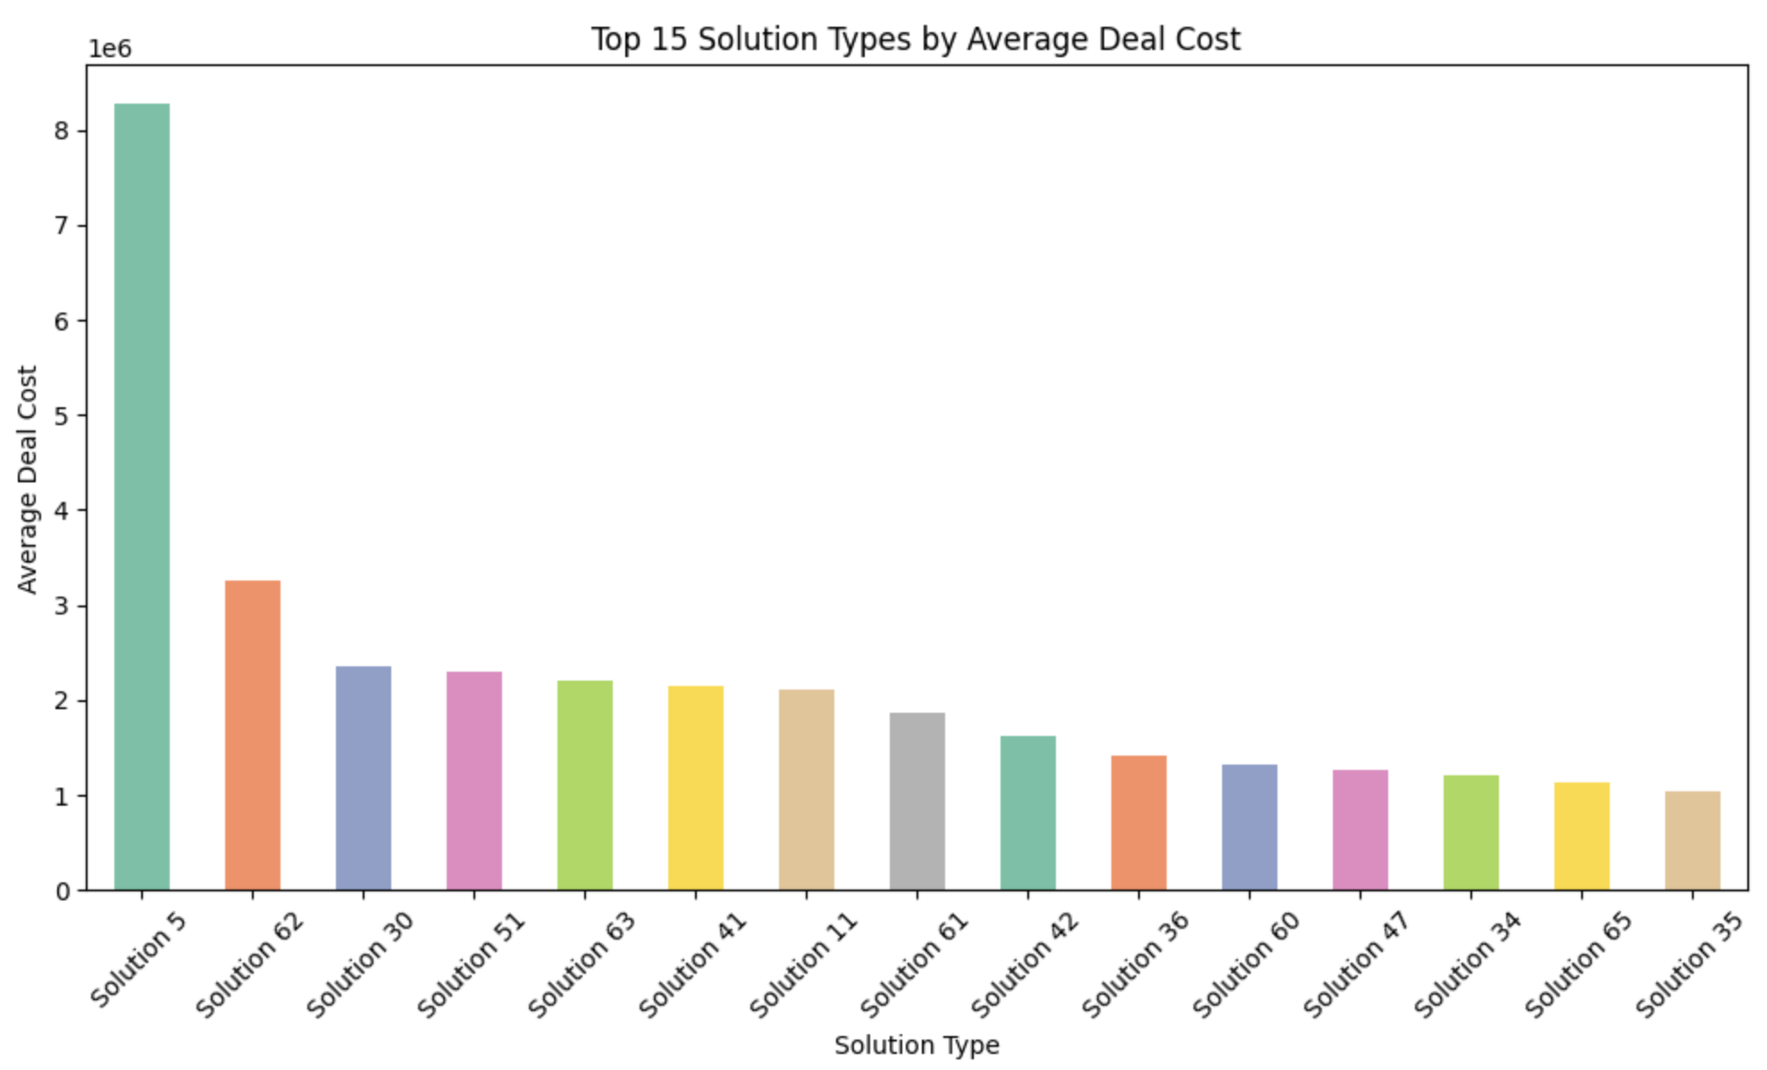
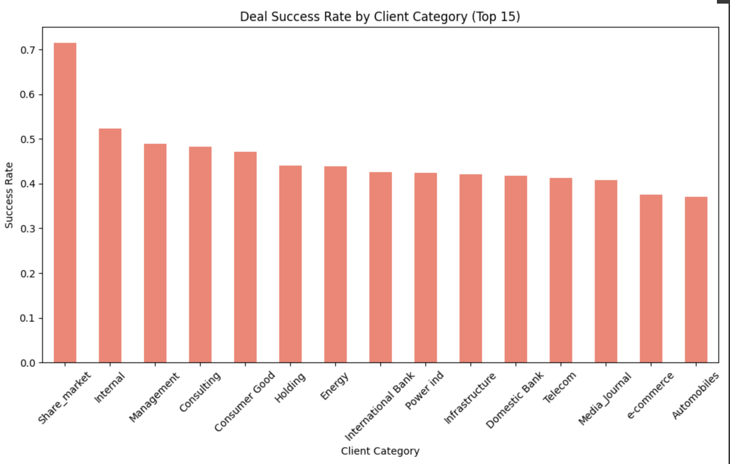
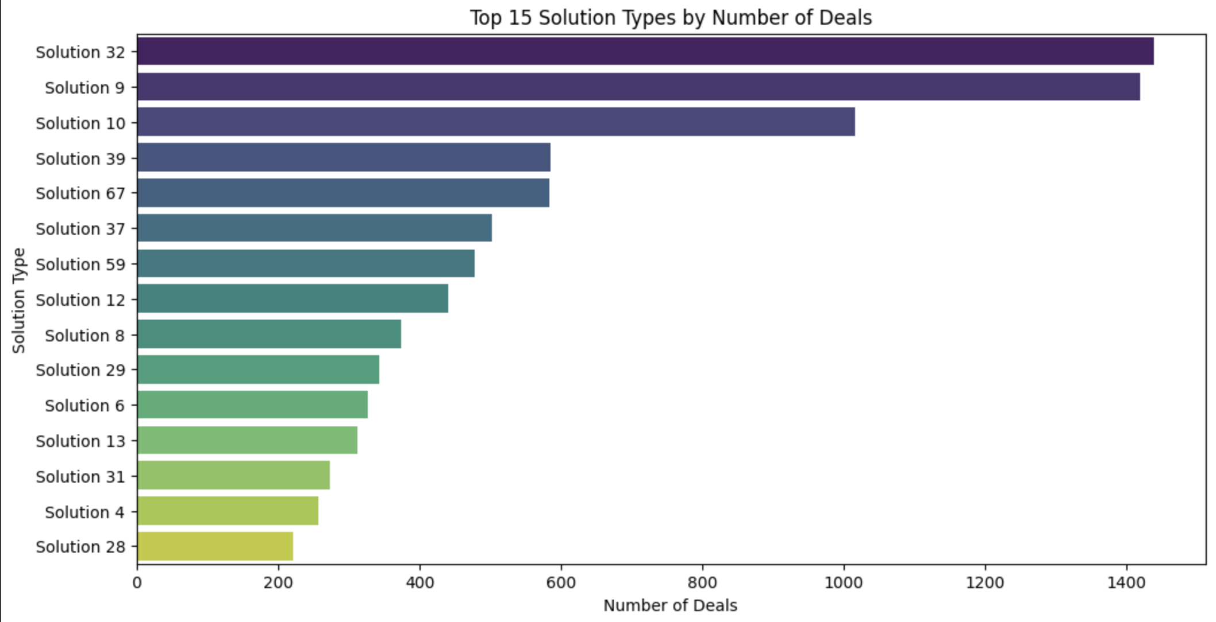
KPMG INDIA- EDA

Slide 11
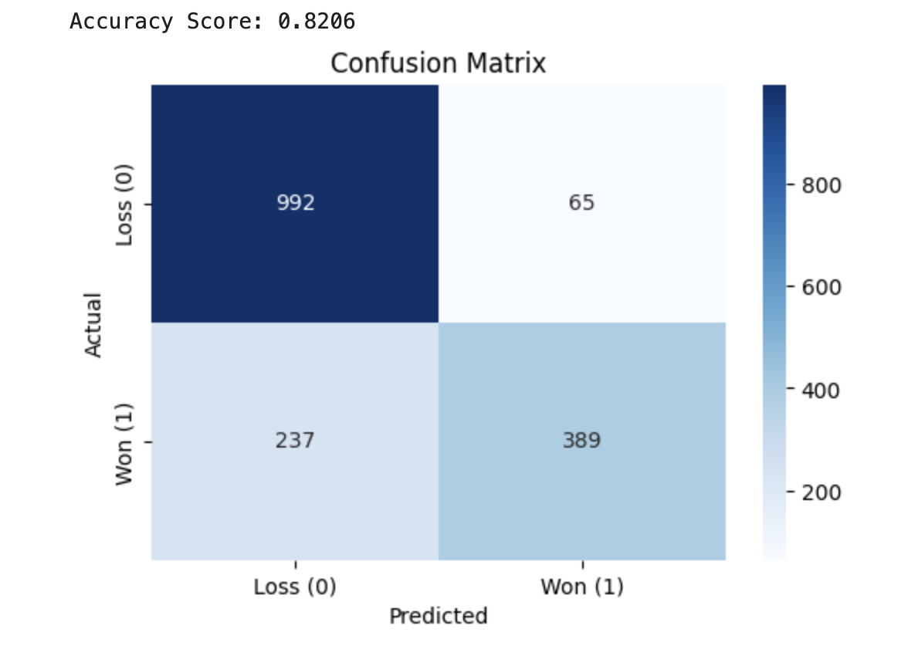
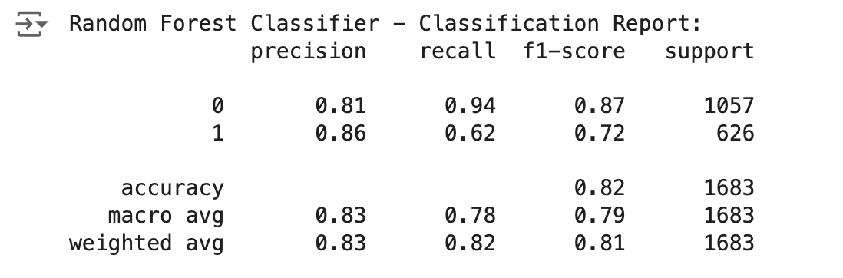
Model Training and Evaluation
True Positives (TP): X (Deals correctly predicted as Won)
True Negatives (TN): X (Deals correctly predicted as Lost)
False Positives (FP): X (Deals incorrectly predicted as Won)
False Negatives (FN): X (Deals incorrectly predicted as Lost)
Algorithm Used: Random Forest ClassifierEnsemble learning technique that combines multiple decision trees for better accuracy and robustness.
Suitable for handling imbalanced datasets when used with SMOTE.
Purpose: Predict deal outcomes (Won vs. Lost).

Slide 12
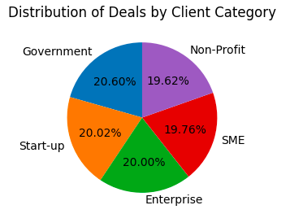
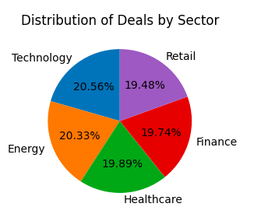
KPMG GLOBAL- EDA
Deal Status

Slide 13
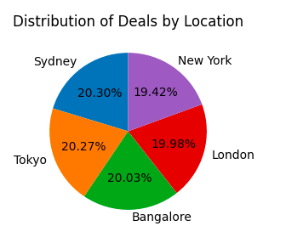
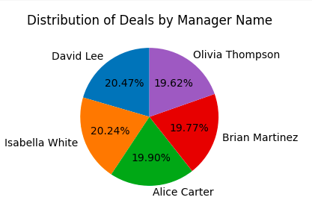
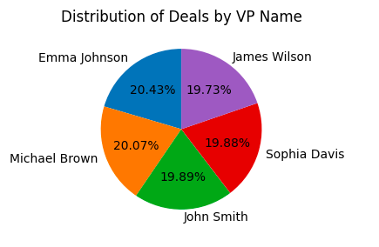
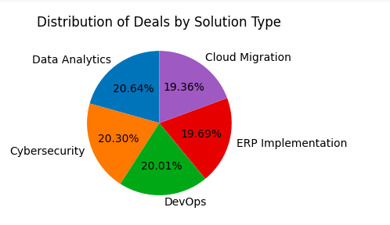

Slide 14
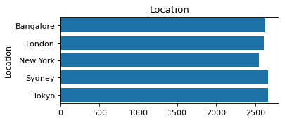
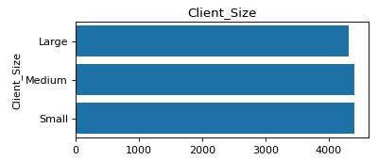
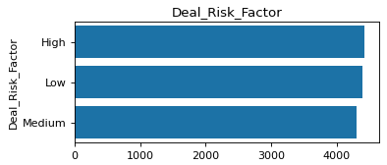
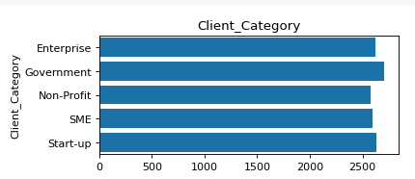
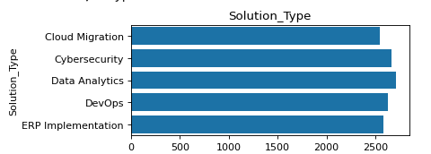
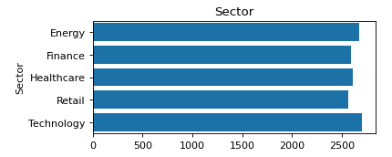

Slide 15
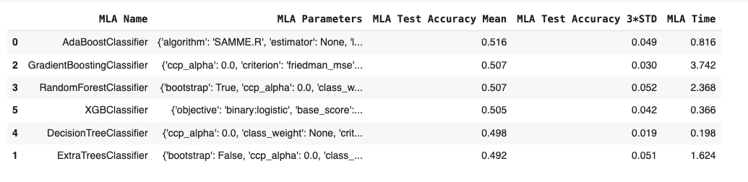
GLOBAL DATA- MODEL EVALUATION

Slide 16
TIMELINE
PHASE | DESCRIPTION | DURATION
Data Pre-Processing, EDA, Feature engineering | Clean the dataset, Perform EDA, create new features | 2- week
Model Training/Testing | Train initial models (logistic regression) | 2- week
Model Optimization and delivery | Optimize models(regularization, validation), delivery | 1- week

